Slide 1

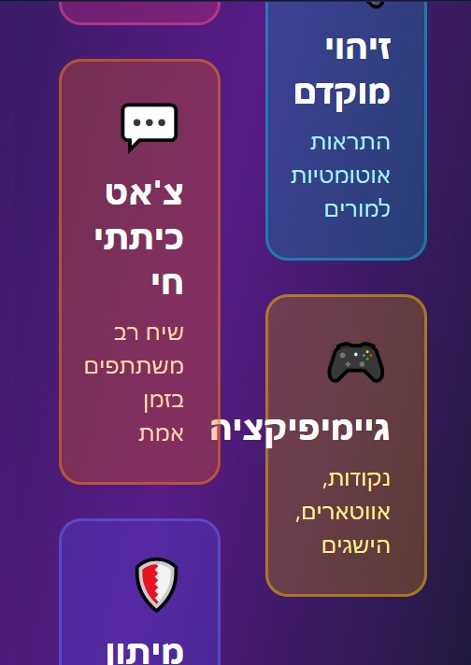
RealTalk

Slide 2
